Slide 1
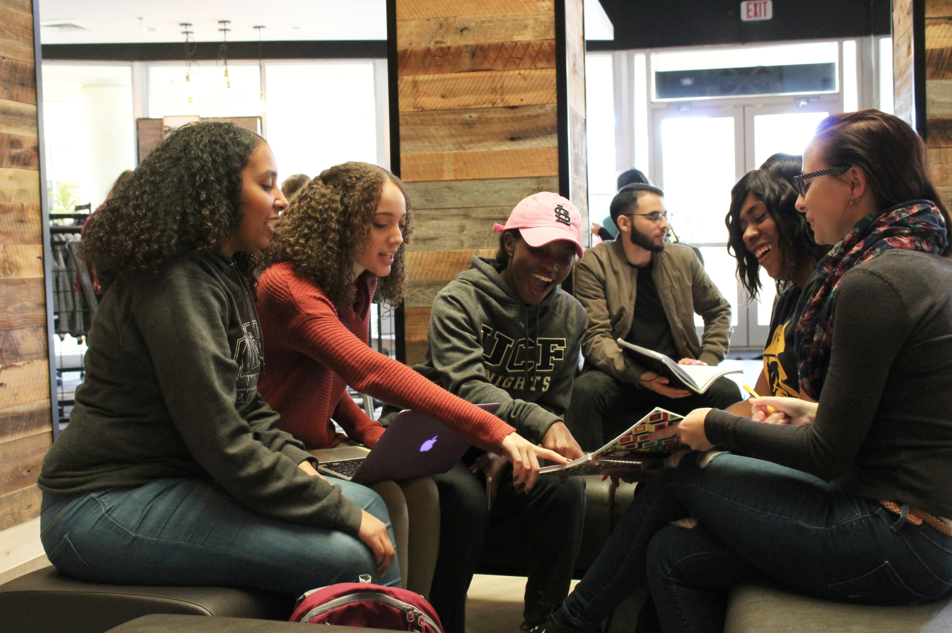
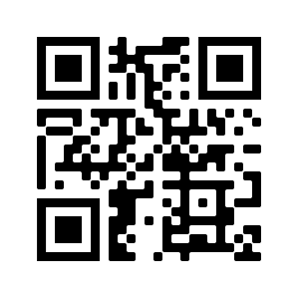
Join
Project
BEST!
JOIN PROJECT BEST!
WHAT IS
PROJECT BEST?
ACADEMIC | ADVISING | PROFESSIONAL
One-on-one Tutoring Early Class Registration Academic Coaching | Supplemental Academic Advising Assistance in Applying for Financial Aid and Scholarships Guidance for Graduate and Professional School Preparation | Networking Opportunities Student Success Workshops Financial Literacy Training Leadership Development
What is
Project
BEST?
Project BEST (Building Exemplary Scholars for Tomorrow) is designed to increase the college retention and graduation rates of its participants and to assist students with making the transition from one level of higher education to the next. Project BEST is tailored to meet the needs of 144 students who are pursuing a degree in any major. Project BEST recruits undergraduate students who identify as first-generation students, who have a demonstrated financial need and/or who have a documented disability. APPLY HERE!
Please submit your completed application via email to Amanda.torrellas@ucf.edu
For more Information, please visit:
https://linktr.ee/SDESTRIO
Contact Program Manager:
Amanda Torrellas
Amanda.Torrellas@ucf.edu

